Slide 1
Uncontrolled copy not subject to amendment
Airframes
Revision 1.00

Slide 2
Chapter 1:
Airframe Design

Slide 3
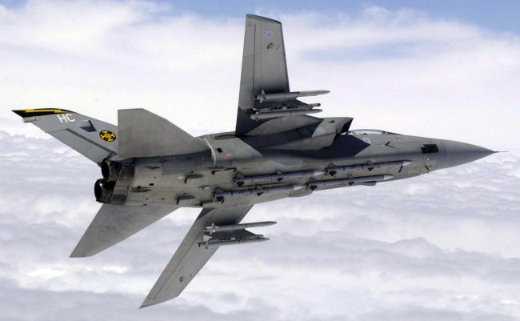

Slide 4
Learning Objectives
The purpose of this chapter is to make you aware of the various influences that affect the shape and performance of an aircraft and to give you an understanding of the structure that make up the airframe itself.
So, by the end of this presentation you will be able to identify the main components of an aircraft, and understand how the underlying structure is made up.
Don’t worry! It is all logical, and hopefully easy to understand.

Slide 5
Introduction
A typical aircraft is made of many thousands of individual parts. Some parts could be made from larger pieces – why do you think manufacturers make the aircraft in so many separate parts?
  Through use, components will wear out, so we need to be able to replace them.
  Some components will inevitably become damaged, so again, they will need replacing.
  Some components are made out of several sub-assemblies in case one part fails, the other components will stop the aircraft from crashing.
Now lets look at the ‘major components’ that make an aircraft.

Slide 6
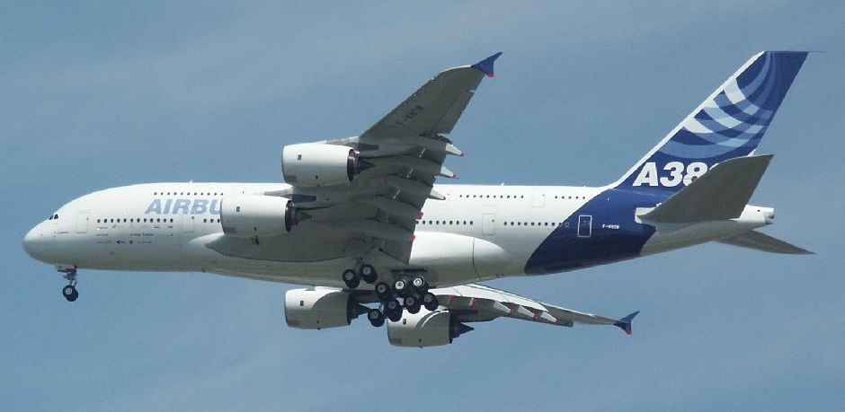
Airframe Components
Any airframe is made up of several ‘major’ components. Try and name some.
Engines
Cockpit/Flight Deck
Fuselage
Rudder
Wings
Flaps
Elevators
Fin
Ailerons
Tailplane
Fuel Tanks
Landing Gear
But can you identify them!

Slide 7
All the suggestions you gave are valid, but for the purposes of this ACP, we will discuss the following 4 major components in more detail later.
Fuselage (or Body)
Wings (or Mainplane)
Undercarriage
Tailplane
Surely that’s not them all though!

Slide 8
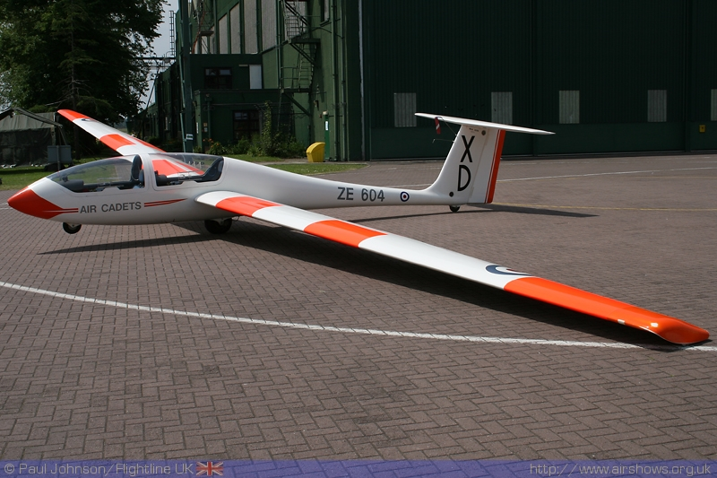
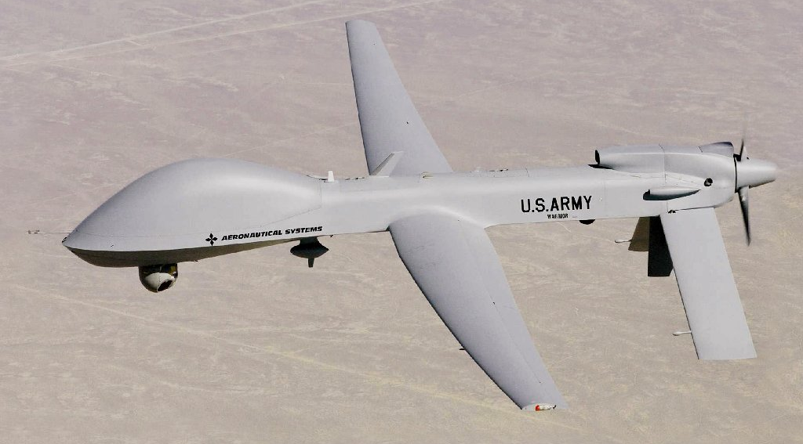
Engines & Cockpit
Now, you may think that this ACP is missing a couple of important components; Engines and a Cockpit.
Although valid, for the purposes of this ACP we will not discuss them further
The Viking glider is an aircraft, and it is fairly obvious that it does not have an engine.
Unmanned Aerial Vehicles (UAVs) for reconnaissance and weapons delivery. They are still aircraft, but have no pilot, therefore do not need a cockpit.

Slide 9
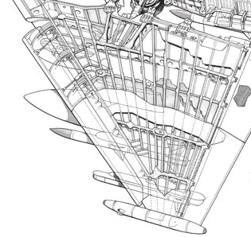
Structural Loads
All the loads that the structure of the airframe carries are resisted by components that are shaped and formed to resist those forces.
Can you think of types of forces (or loads) that would be present in components in an aircraft wing?
Tearing
Squashing
Pulling
Bending
Twisting

Slide 10
Structural Elements
The airframe designer has 4 types of structural element that can be used to resist these forces – they are;
  Ties: These resist tension or ‘pulling’ forces
  Struts: These resist compression or ‘squashing’ forces
  Beams: These resist ‘bending’ forces
  Webs: These resist ‘twisting’ and ‘tearing’ forces
These elements are often also referred to as structural members
We can now look at these members in more detail.

Slide 11
Ties
Ties are members subject purely to tension (pulling). A tie can be a rigid member such as a tube, or simply a wire.
Can you see any elements of the room you are currently in that could be a ‘tie’?
Force
Tie
Force

Slide 12
Struts
Struts are members in compression (squashing). It is much more difficult to design a strut than a tie, because a strut is liable to bend or buckle.
If a strut is put under compression until it fails, a long strut will always buckle, a short strut will always crack (crush) and a medium strut will either buckle or crack, or sometimes both.
Hollow tubes generally make the best struts.
Force
STRUT
Force

Slide 13
Beams
Beams are members that carry loads at an angle (generally at right angles) to their length, and take loads in bending.
The beams in an airframe include most of the critical parts of the structure, such as the wing main spars and stringers. Even large structures in the aircraft are acting as a beam, for instance, the fuselage.
Force
BEAM
Support
Support

Slide 14
Webs
Webs (or shear webs) are members carrying loads in shear, like tearing a piece of paper. The ribs and the skin within the wing itself are shear webs.
Have a look around the room you are now in, and see if you can spot any of the members we have looked at used in normal everyday things?
Force
WEB
Force

Slide 15
Practical Examples
So did you spot any examples of ‘Structural Elements’ in the room about you?!
  Table Leg: Strut
  Table Top/Door: Shear Web
  Table Top Rail/Door Lintel: Beam
But did you spot any Ties?
These are not so common in a normal room, but keep an eye out whilst in the rest of the building, and see if you spot anything.

Slide 16
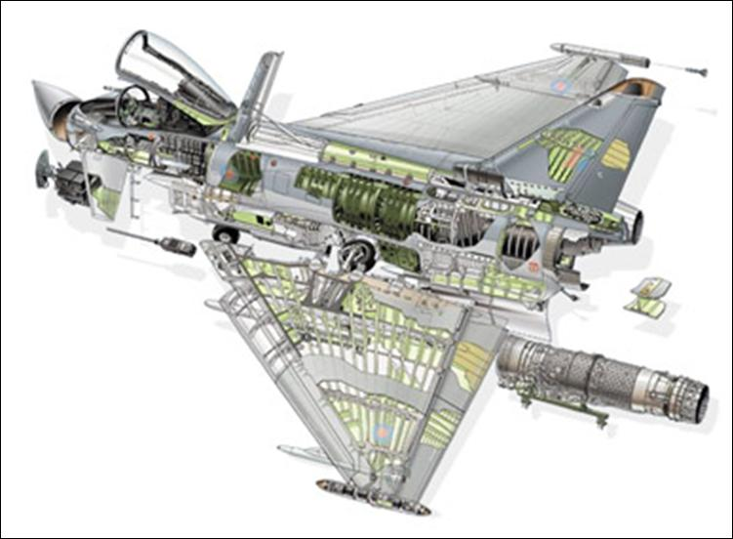
Airframe Structures
You may get the idea that each part of an airframe is either a Tie, a Strut, a Beam or a Web, but this is not always the case.
Some items, such as wing spars, act almost entirely as one type of member, but others act as different members for different loads. For instance, the main spar near the fuselage will transmit load in bending and in shear.

Slide 17
Airframe Structures
By carefully mixing these members, and making sure that each part of each member is taking its share of the loads, the designer will achieve the greatest strength with minimum weight, and so get the best operating efficiency and maximum safety.
As an example, let us look at how we could reduce the weight of a solid metal beam being used as a bridge across a stream.

Slide 18
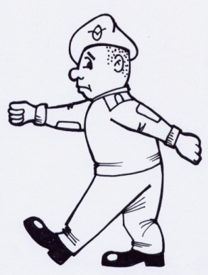
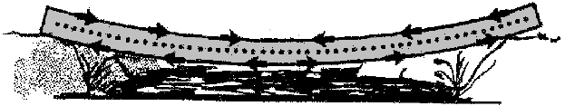
‘The Bridge’
When the cadet walks over the bridge made of a solid block, it bends under his weight.
The top surface is in compression (being squashed).
The bottom surface is in tension (being pulled). We can assume that the centre is least affected (neither pulled or squashed).
Solid beam bridge (Very Heavy!)
The effect of a weight on a solid beam bridge

Slide 19
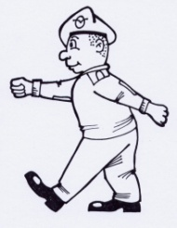
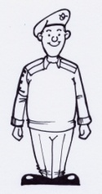
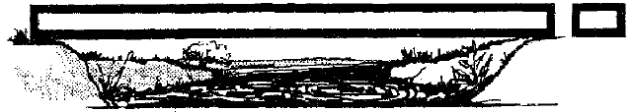
Lightening the Structure
As the centre portion of the beam is least affected by the forces, we could make the bridge lighter by removing some or all of this centre part.
This would have very little effect on its strength. We must ensure that the top and bottom sections are still strong enough to carry the load.
You can see from our earlier examples, that the top section is acting like a strut, and the bottom section acts like a tie.
The bridge with the centre ‘hollowed out’

Slide 20
Practical Exercise
Now we can look at the sides of the bridge. If you take hold of a piece of paper and pull it from each end, you will see that it is quite strong in tension.
The paper is strong in tension

Slide 21
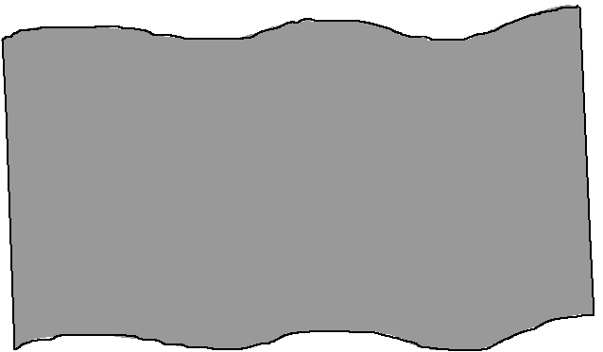
Practical Exercise
Now, if you push the edges of the paper inwards, it distorts easily, because it has very little resistance to compression loads. Because the paper is so thin, it will crumple, or buckle easily.
The paper is weak in compression

Slide 22
Practical Exercise
Now if we roll a same size piece of paper into a cylinder (along the long side), and then push the ends together. It is now much stronger, because of its shape.
So the sides of the bridge are important to support the top and bottom, preventing the bridge buckling and distorting out of shape. Try balancing a weight on the top and see what happens.

Slide 23
Practical Exercise
When our paper tube does fail, it is because the walls buckle.
Try making a shorter tube, and see if it will support more weight. If we braced the inside or corrugated the walls, it would prevent them buckling, and make it even stronger.
We can do this to the bridge, and use even thinner walls, provided they are properly braced.

Slide 24
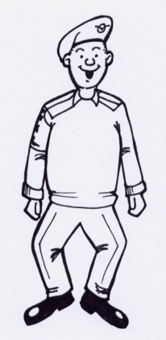
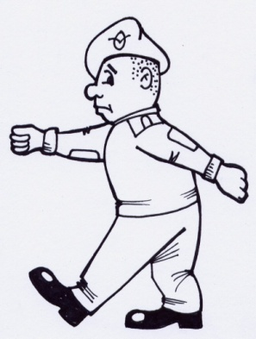
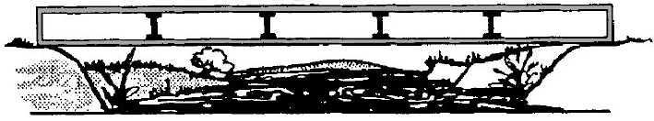
Back to that Bridge!
It is now much lighter, and looks something like a modern bridge or part of an airframe.
However, this is a beam supported at both ends. Let us now look at a beam only supported at one end

Slide 25
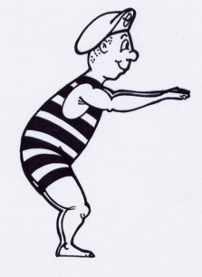
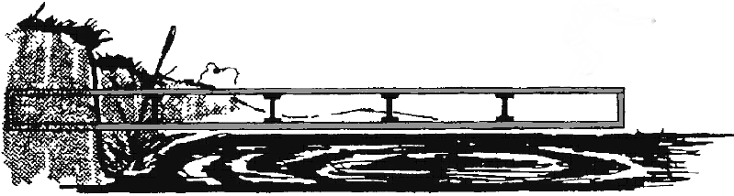
‘The Diving Board’
So what happens if the bridge can be supported at one end only?
Suppose our bridge is to be used as a diving board. It can still carry a load, but the whole of the force is taken at its supported end.
Provided the outer, unsupported end is strong enough to carry the cadet, we could make it smaller than the supported end.

Slide 26
The Cantilever
The supported end needs to be strong enough to carry the weight and bending from the cadet plus the whole of the structure.
We would want to make this bigger than our previous bridge.
The strongest, lightest structure to do the job of our diving board would look like the previous picture. This is called a cantilever structure.

Slide 27
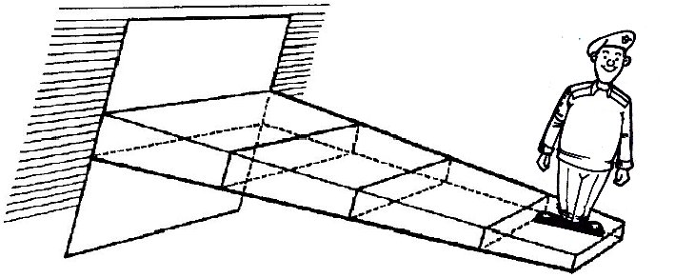
What is a Cantilever
Like the supported structure, the cantilever will still bend downwards, but this time the top will be in tension (like a tie) and the bottom in compression (like a strut).
The cantilever structure is widely used in aircraft, because it contains many structures which are attached at one end. The wings are just one example of this.

Slide 28
Cantilever Structure
Because they need to be much stronger and stiffer at the root (the attachment to the fuselage), they are wider and deeper there than at the tip, where loads are much less.
There are many other examples of cantilever structure.
Can you think of any others?
The Forth Bridge
A Cantilever Truss
Balconies

Slide 29
Conclusions
To build an airframe to cope with the ever-increasing demand for higher weights and speeds, and to do this with the lightest possible structure weight, the designer must solve many problems.
A thorough under-standing of the loads on an aircraft structure is needed. Of course, these structures must also be safe and reliable.
You should now have an understanding of the ‘major components’ that make up an airframe, as well as what major parts make up an airframe, and the different types of structural elements used in the construction of the airframe itself.
Any Questions?

Slide 30
Questions
Here are some questions for you!
How many ‘Major Components’ in an airframe?
  3
  4
  8
  2
How many different structural components in an airframe?
  2
  5
  4
  3
A Tie is a structural member that resists what type of load?
Notes:
The answers to these questions are as follows;
1. There are 4 ‘Major Components’ in an airframe – Fuselage, Wings, Undercarriage and Tailplane
2. There are 4 different structural elements that can be used in an airframe – Ties, Struts, Shear Webs and Beams.
3. A Tie resists tensional loads

